Slide 1


Welcome you all
MySQL
Day 2
D.Sakthivel
Assistant Professor & Trainer,
KGiSL Micro College
KGiSL Campus, Coimbatore – 641 035.

Slide 2
Day 2 & 3
Arithmetic Operators
Between and Not Between
Date Functions
Modeling Database
Applying ER Model Concepts
ER Model to Relational Database
Constraint
Not Null
Primary Key
Foreign Key
Check Constraint
Set Operation
JOIN – Natural, Inner Join, Right, Left Join
JOIN with Group by and Aggregate Function

Slide 3
Arithmetic Operator:
MySQL Arithmetic Operators | Operation | Example
+ | Addition Operator | SELECT 10 + 2 = 12
– | Subtraction Operator | SELECT 10 – 2 = 8
* | Multiplication Operator | SELECT 10 * 2 = 20
/ | Division Operator | SELECT 10 / 2 = 5
DIV | Integer Division | SELECT 10 / 2 = 5
% or MOD | Modulus Operator | SELECT 10 % 2 = 0 SELECT 10 % 3 = 1

Slide 4
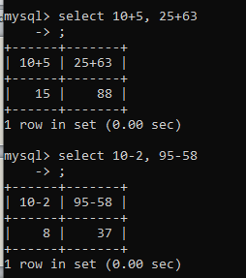
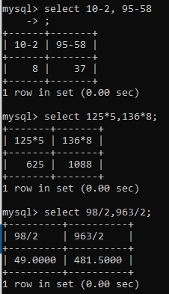
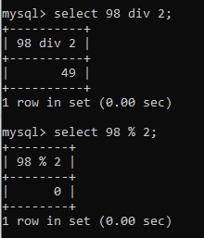
Arithmetic Operator:

Slide 5
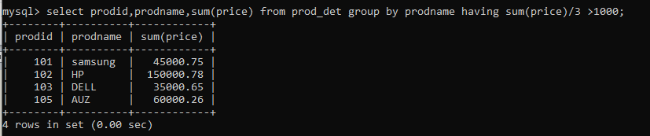
Arithmetic Operator:

Slide 6
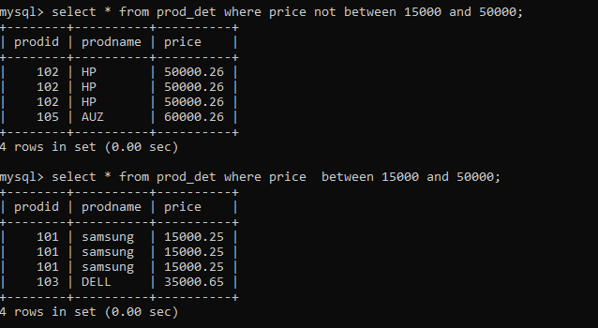
Between and Not Between:

Slide 7
MySQL Date Functions:
Along with strings and numbers, you often need to store date and/or time values in a database, such as an user's birth date, employee's hiring date, date of the future events, the date and time a particular row is created or modified in a table, and so on.
This type of data is referred as temporal data and every database engine has a default storage format and data types for storing them.

Slide 8
MySQL Date Functions:
Type | Default format | Allowable values
DATE | YYYY-MM-DD | 1000-01-01 to 9999-12-31
TIME | HH:MM:SS or HHH:MM:SS | -838:59:59 to 838:59:59
DATETIME | YYYY-MM-DD HH:MM:SS | 1000-01-01 00:00:00 to 9999-12-31 23:59:59
TIMESTAMP | YYYY-MM-DD HH:MM:SS | 1970-01-01 00:00:00 to 2037-12-31 23:59:59
YEAR | YYYY | 1901 to 2155

Slide 9
MySQL Date Functions:
MySQL Curdate is a Date Function, which is useful to return the current date value in YYYY-MM-DD or YYYYMMDD format.
MySQL Date Functions | Description
ADDDATE() | Add Date Value in intervals to a given Date.
ADDTIME() | This adds Time
CONVERT_TZ() | This MySQL Date function convert date and time from one time zone to another.
CURDATE() | Returns the Current date
CURRENT_DATE, CURRENT_DATE() | Synonym of CURDATE()
CURRENT_TIME(), CURRENT_TIME | Synonym of CURTIME() function
CURRENT_TIMESTAMP() ,CURRENT_TIMESTAMP | Synonym of NOW() function
CURTIME() | This MySQL function returns the current Time
DATE() | It extracts the date part from the Given Date or DateTime expression

Slide 10
MySQL Date Functions:
DATE_ADD() | It adds a given intervals to the date expression
DATE_FORMAT() | This method formats the Date as per our requirements.
DATE_SUB() | This subtracts the specified intervals from the given date.
DATEDIFF() | Subtracts one date from another and returns the difference.
DAY() | Synonym of DAYOFMONTH() function.
DAYNAME() | This MySQL date function returns the name of the Weekday. For example Monday
DAYOFMONTH() | It returns the day number of the Month from 1 to 31
DAYOFWEEK() | This returns the Weekday index of the user given date.
DAYOFYEAR() | Returns the Day of the Year or Day number, i.e., 1 to 366
EXTRACT() | Use this to extract part of a date.
FROM_DAYS() | This MySQL date function converts given day number to date.

Slide 11
MySQL Date Functions:
GET_FORMAT() | This returns the date format string.
HOUR() | Returns the Hour value from a given Time.
LAST_DAY | It returns the last Day of the Month on a given date.
LOCALTIME(), LOCALTIME | Synonym of NOW() function
LOCALTIMESTAMP(), LOCALTIMESTAMP | Synonym of NOW() function
MAKEDATE() | It is used to create or make a date from the specified Year, and day of the year
MAKETIME() | This will Create or make time from Hour, Minute, Second
MICROSECOND() | Returns the Microseconds from the given Time or DateTime.
MINUTE() | This function returns the Minutes value from given Time or DateTime.
MONTH() | It retunes the Month Number (1 – 12)
MONTHNAME() | Returns the Month name or Name of the Month (January, February, etc.)
NOW() | This MySQL Date function returns the Current Date and Time.

Slide 12
MySQL Date Functions:
PERIOD_ADD() | It adds the user specified period to a year-Month
PERIOD_DIFF() | Returns the difference between the two periods. It returns the number of months between those two periods.
SECOND() | Returns the seconds value (0-59) from a given Time.
STR_TO_DATE() | This function converts String to date.
SYSDATE() | Returns the current system date and time at which the function executed
TIME() | This MySQL date function extracts the time portion from given DateTime or expression
TIME_FORMAT() | Use this to format the given expression as time.
TIME_TO_SEC() | This method converts the given time to second.
TIMEDIFF() | It subtracts time.
TIMESTAMP() | It returns the Date or DateTime expression.

Slide 13
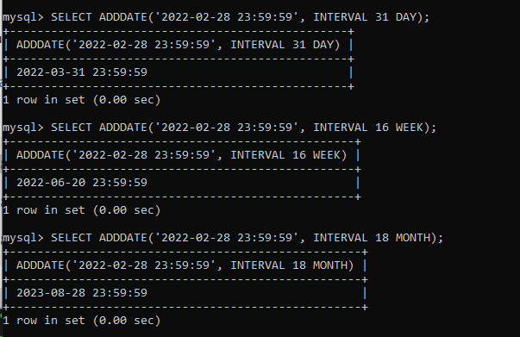
MySQL Date Functions:
ADDDATE(Date, INTERVAL expression Unit);

Slide 14
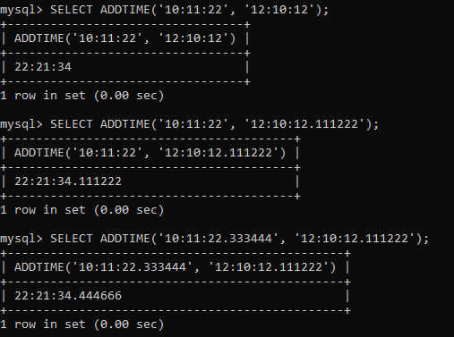
MySQL Date Functions:
ADDTIME(DateTime1 or Time_Expression1, Time_Expression2);

Slide 15
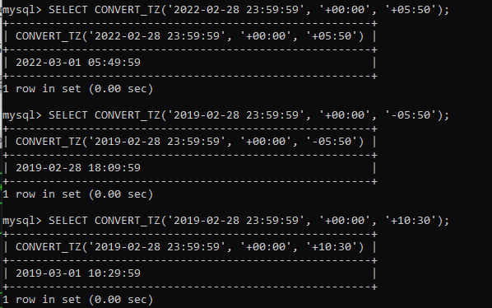
MySQL Date Functions:
CONVERT_TZ(Date, from_timezone, to_timezone);

Slide 16
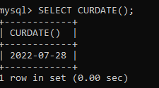
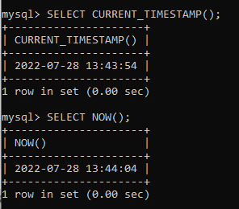
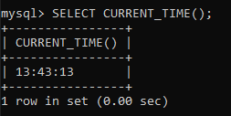
MySQL Date Functions:
CURRENT DATE,TIME,HOURS,MINUTES,SECONDS:

Slide 17
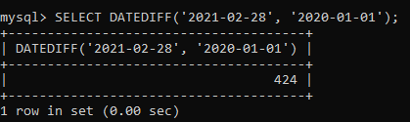
MySQL DATEDIFF Function
MySQL DATEDIFF function is one of the Date methods, which is useful to find the difference between two dates and returns the number of days.
DATEDIFF(Expression1, Expression2);

Slide 18
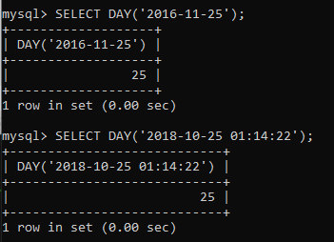
MySQL Day Function
MySQL Day is one of the Date Functions, which is useful to return the day of the month range from 0 to 31.
Or, this MySQL function returns the Day number from a given date or DateTime expression.
DAY(date or expression);

Slide 19
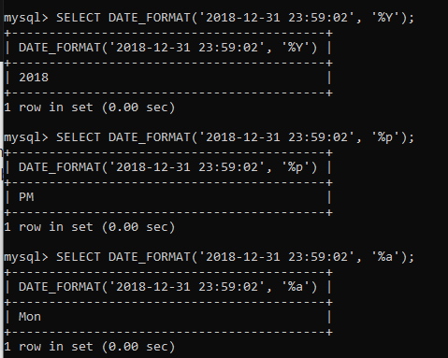
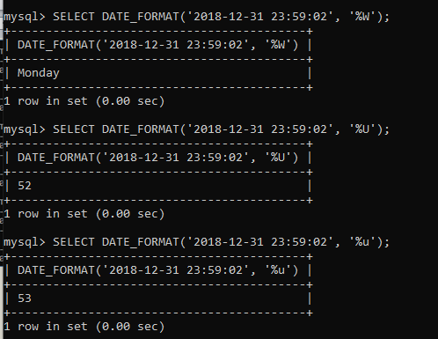

Slide 20
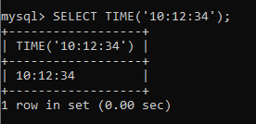
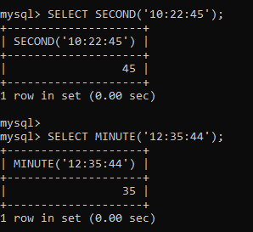
MySQL Time Function
MySQL Time Function is useful to extract the Time part from the given DateTime. In this study, we show you how to use this method to extract the time value from the given expression with an example and the syntax is
TIME(Time or DateTime or expression);

Slide 21
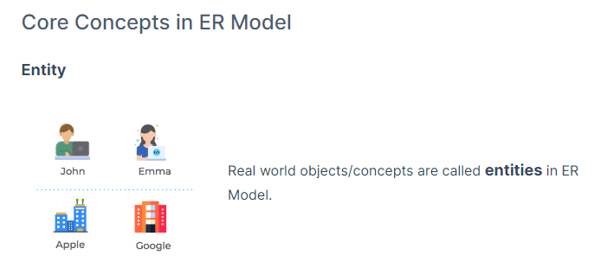
Modelling Databases: Part 1
To model a database, we have to first understand the business requirements at conceptual level, which is later translated into a relational database.
For understanding the business requirements at a conceptual level, we use Entity Relationship Model (ER Model)

Slide 22
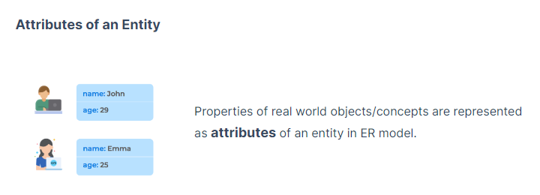
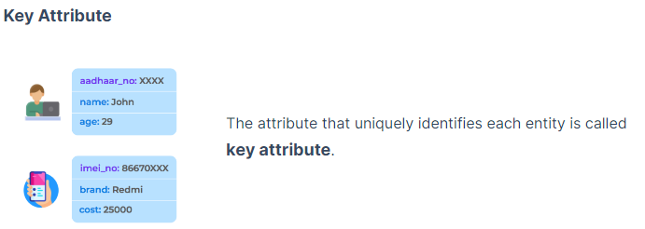
Modelling Databases: Part 1

Slide 23
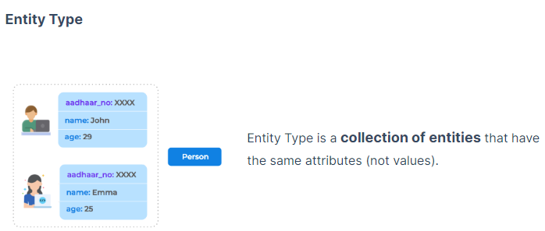
Modelling Databases: Part 1

Slide 24
Modelling Databases: Part 1
Relationships
Association among the entities is called a relationship.
Example:
Person has a passport.
Person can have many cars.
Each student can register for many courses, and a course can have many students.
Types of relationships
One-to-One Relationship
One-to-Many or Many-to-One Relationship
Many-to-Many Relationship

Slide 25
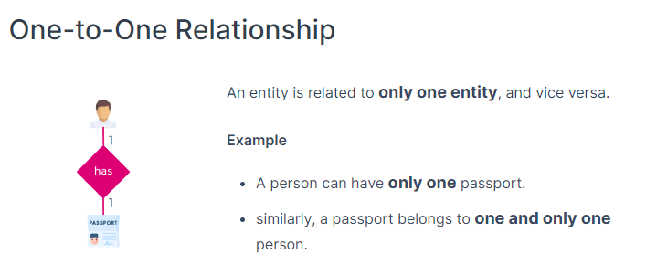
Modelling Databases: Part 1

Slide 26
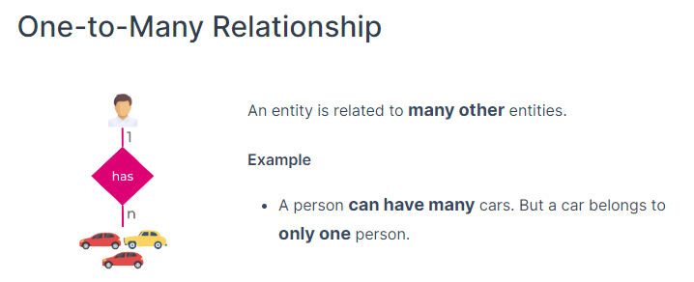
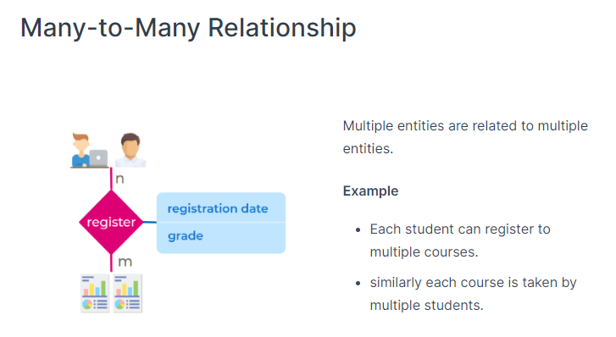
Modelling Databases: Part 1

Slide 27
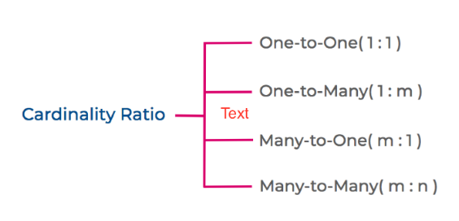
Modelling Databases: Part 1
Cardinality Ratio
Cardinality in DBMS defines the maximum number of times an instance in one entity can relate to instances of another entity.

Slide 28
Applying ER Model Concepts
Applying ER Model Concepts
E-commerce Application
In a typical e-commerce application,
Customer has only one cart. A cart belongs to only one customer
Customer can add products to cart
Cart contains multiple products
Customer can save multiple addresses in the application for further use like selecting delivery address
Let’s apply the concepts of ER Model to this e-commerce scenario.
Entity types
Customer
Product
Cart
Address
Relationships

Slide 29
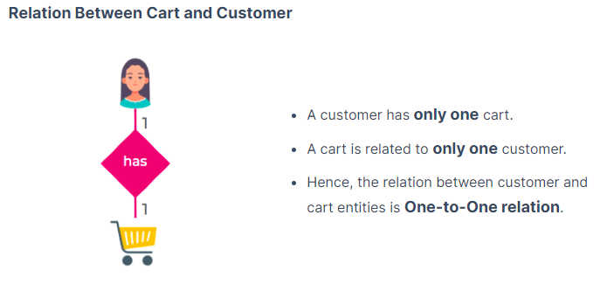
Applying ER Model Concepts

Slide 30
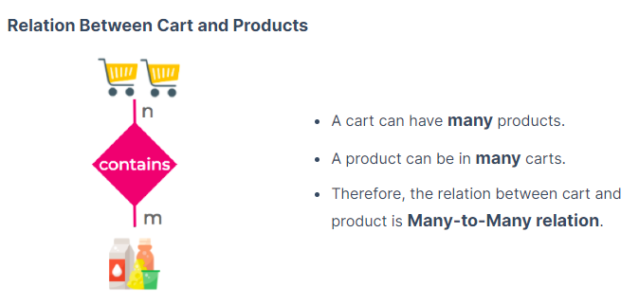
Applying ER Model Concepts

Slide 31
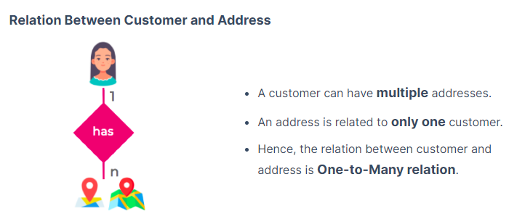
Applying ER Model Concepts

Slide 32
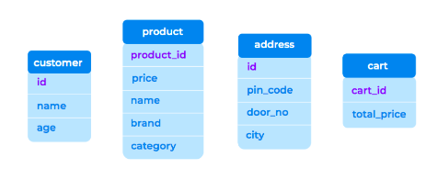
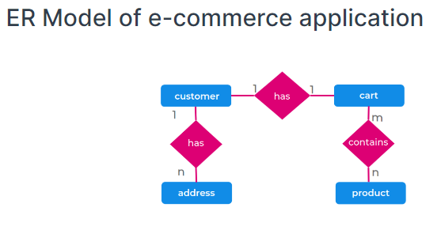
Applying ER Model Concepts
Attributes
Following are the attributes for the entity types in the e-commerce scenario. Here, attributes like id, product_id, etc., are key attributes as they uniquely identify each entity in the entity type.

Slide 33
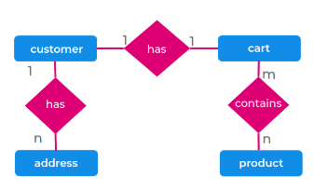
ER Model to Relational Database
E-commerce Application
In a typical e-commerce application,
Customer has only one cart. A cart belongs to only one customer
Customer can add products to cart
Cart contains multiple products
Customer can save multiple addresses in the application for further use like selecting delivery address

Slide 34
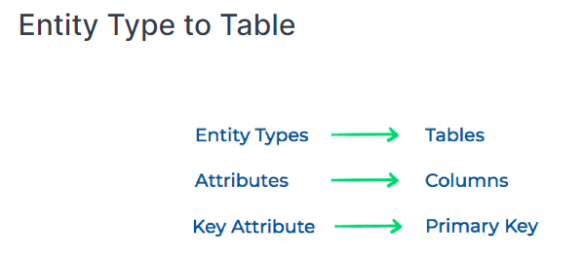
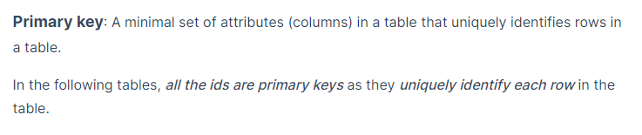
ER Model to Relational Database

Slide 35
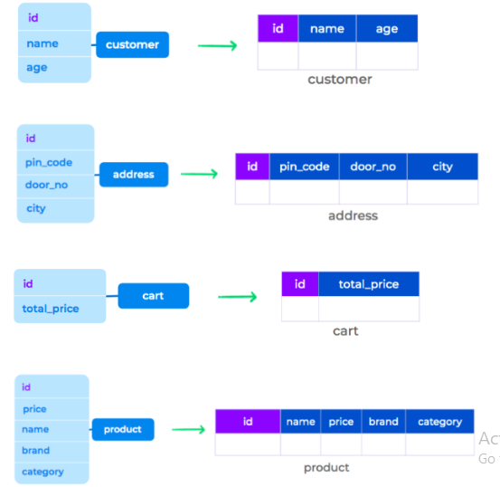
ER Model to Relational Database

Slide 36
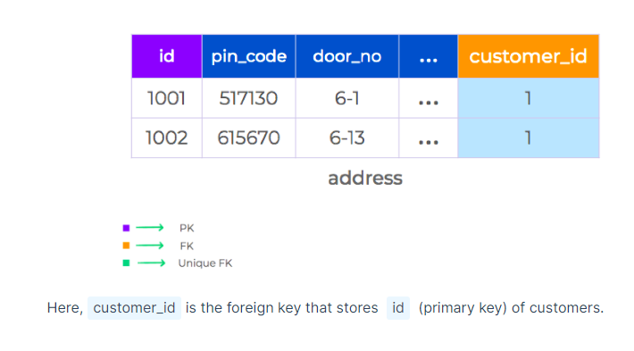
ER Model to Relational Database
Relationships
Relation Between Customer and Address - One to Many Relationship
A customer can have multiple addresses.
An address is related to only one customer.
We store the primary key of a customer in the address table to denote that the addresses are related to a particular customer. This new column/s in the table that refer to the primary key of another table is called Foreign Key.

Slide 37
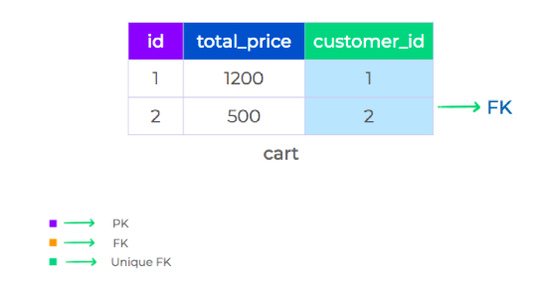
ER Model to Relational Database
Relation Between Cart and Customer - One to One Relationship
A customer has only one cart.
A cart is related to only one customer.
This is similar to one-to-many relationship. But, we need to ensure that only one cart is associated to a customer

Slide 38
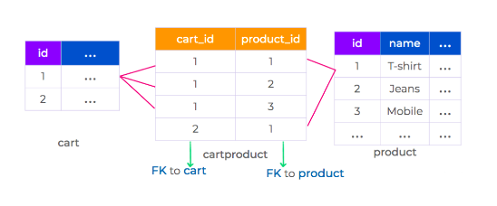
ER Model to Relational Database
Relation Between Cart and Products - Many to Many Relationship
A cart can have many products.
A product can be in many carts.
Here, we cannot store either the primary key of a product in the cart table or vice versa. To store the relationship between the cart and product tables, we use a Junction Table.

Slide 39
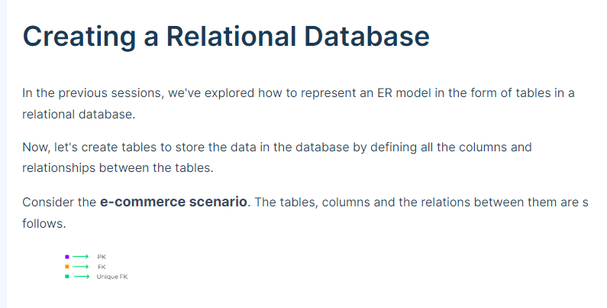

Slide 40
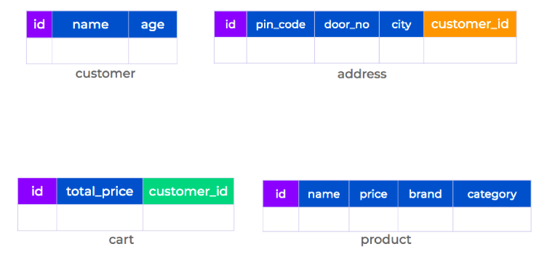
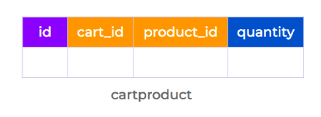

Slide 41
What is Constraint?
A constraint is simply a restriction placed on one or more columns of a table to limit the type of values that can be stored in that column.
Constraints provide a standard mechanism to maintain the accuracy and integrity of the data inside a database table.
There are several different types of constraints in SQL, including:
NOT NULL
PRIMARY KEY
FOREIGN KEY
CHECK

Slide 42
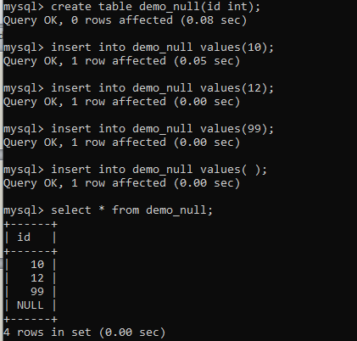
Null Values

Slide 43
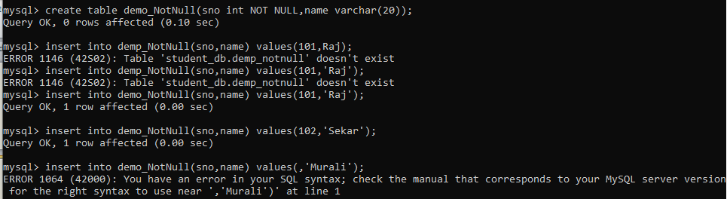
NOT NULL Constraint
The NOT NULL constraint specifies that the column does not accept NULL values.
This means if NOT NULL constraint is applied on a column then you cannot insert a new row in the table without adding a non-NULL value for that column.

Slide 44
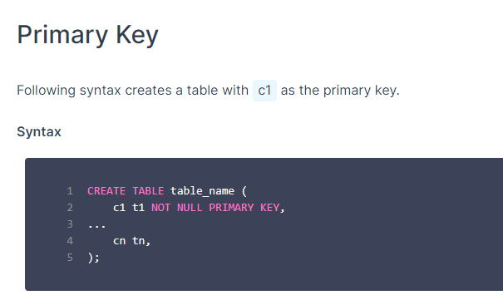

Slide 45
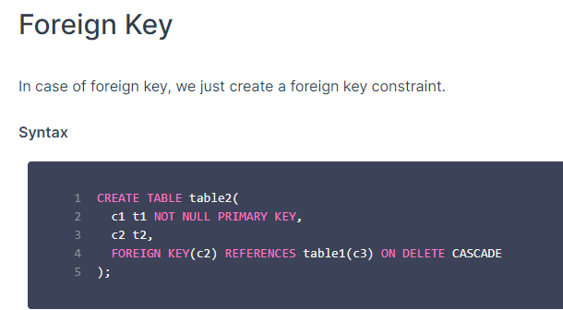

Slide 46
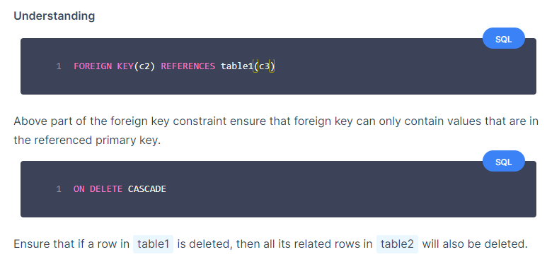

Slide 47
Primary Key:
A primary key is a column or a set of columns that uniquely identifies each row in the table.
The primary key follows these rules:
A primary key must contain unique values.
If the primary key consists of multiple columns, the combination of values in these columns must be unique.
A primary key column cannot have NULL values.
Any attempt to insert or update NULL to primary key columns will result in an error.
Note that MySQL implicitly adds a NOT NULL constraint to primary key columns.
A table can have one an only one primary key.
A primary key column often has the AUTO_INCREMENT attribute that automatically generates a sequential integer whenever you insert a new row into the table.

Slide 48
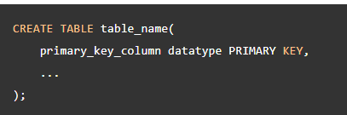
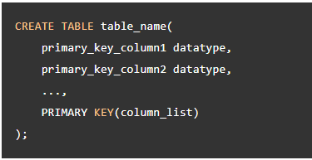
Primary Key:
Syntax:

Slide 49
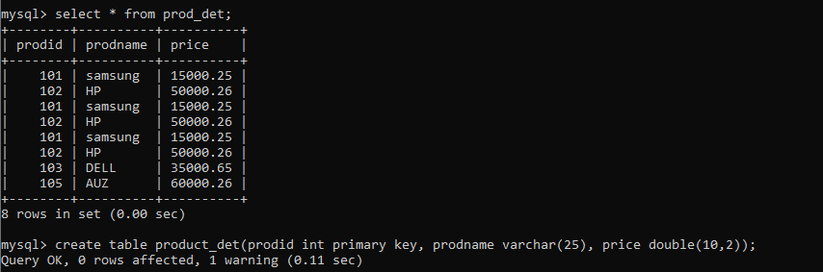
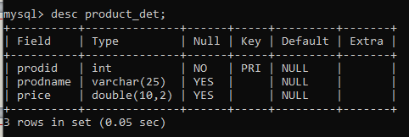
Primary Key- Example:

Slide 50
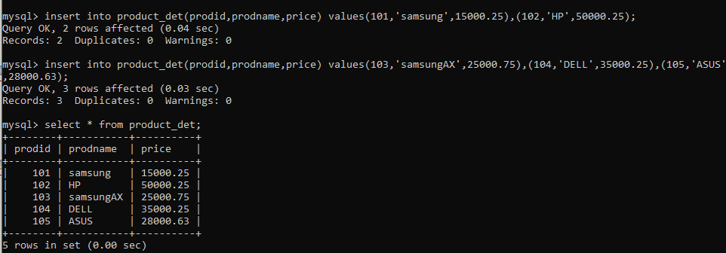
Primary Key- Example:

Slide 51

Primary Key- Example:

Slide 52

Foreign Key:
A foreign key is a column or group of columns in a table that links to a column or group of columns in another table.
The foreign key places constraints on data in the related tables, which allows MySQL to maintain referential integrity.

Slide 53
Foreign Key:
Syntax:
CREATE TABLE table_name (FOREIGN KEY (column_name) REFERENCE table_name(Referencing column_name in table_name));

Slide 54



Foreign Key:

Slide 55
MySQL AUTO_INCREMENT Keyword:
Auto-increment allows a unique number to be generated automatically when a new record is inserted into a table.
Often this is the primary key field that we would like to be created automatically every time a new record is inserted.
MySQL uses the AUTO_INCREMENT keyword to perform an auto-increment feature.
By default, the starting value for AUTO_INCREMENT is 1, and it will increment by 1 for each new record.

Slide 56

MySQL AUTO_INCREMENT Keyword:

Slide 57

MySQL AUTO_INCREMENT Keyword:
To let the AUTO_INCREMENT sequence start with another value, use the following SQL statement:
ALTER TABLE student_info AUTO_INCREMENT=100;

Slide 58

MySQL AUTO_INCREMENT Keyword:

Slide 59

CHECK Constraint
The CHECK constraint is used to restrict the values that can be placed in a column.
For example, the range of values for a price column can be limited by creating a CHECK constraint that allows values only from 3,000 to 10,000. This prevents price from being entered beyond the regular salary range. Here's an example:

Slide 60

CHECK Constraint

Slide 61
Set Operation:
Union:
MySQL Union is an operator that allows us to combine two or more results from multiple SELECT queries into a single result set.
It comes with a default feature that removes the duplicate rows from the result set.
SELECT column_list FROM table1
UNION
SELECT column_list FROM table2;

Slide 62


Set Operation:
Union:

Slide 63
Set Operation:
Union ALL:
MySQL Union is an operator that allows us to combine two or more results from multiple SELECT queries into a single result set.
It comes with a default feature from the result set.
SELECT column_list FROM table1
UNION ALL
SELECT column_list FROM table2;

Slide 64

Set Operation:
Union ALL:

Slide 65
Set Operation:
Union ALL:
MySQL Union is an operator that allows us to combine two or more results from multiple SELECT queries into a single result set.
It comes with a default feature from the result set.
SELECT column_list FROM table1
UNION ALL
SELECT column_list FROM table2;

Slide 66
JOINS
So far, we have learnt to analyse the data that is present in a single table.
But in the real-world scenarios, often, the data is distributed in multiple tables.
To fetch meaningful insights, we have to bring the data together by combining the tables.
We use JOIN clause to combine rows from two or more tables, based on a related column between them.
There are various types of joins, namely Natural join, Inner Join, Full Join, Cross Join, Left join, Right join.

Slide 67
NATURAL JOIN
combines the tables based on the common columns.
Combining two tables:
SELECT * FROM table1 INNER JOIN table2 ON table1.id = table2.id;
Combining three tables:
SELECT * FROM table1 INNER JOIN table2 ON table1.id = table2.id INNER JOIN table3 ON table2.id = table3.id;

Slide 68


Slide 69


Slide 70



Slide 71


Slide 72
INNER JOIN
“INNER JOIN combines rows from both the tables if they meet a specified condition”.
MySQL Inner Join type returns the records or rows present in both tables If there is at least one match between columns. Or, we can simply say, MySQL Inner Join returns the rows (or records) present in both tables as long as the condition after the ON Keyword is TRUE.
SYNTAX:
SELECT Table1.Column(s), Table2.Column(s) FROM Table1 INNER JOIN Table2 ON Table1.Common_Column = Table2.Common_Column
--OR We can Simply Write it as
SELECT Table1. Column(s), Table2. Column(s) FROM Table1 JOIN Table2 ON Table1.Common_Column = Table2.Common_Column

Slide 73

INNER JOIN

Slide 74

INNER JOIN

Slide 75
Outer Join
Outer joins are joins that return matched values and unmatched values from either or both tables.
The biggest difference between an INNER JOIN and an OUTER JOIN is that the inner join will keep only the information from both tables that's related to each other (in the resulting table).
An Outer Join, on the other hand, will also keep information that is not related to the other table in the resulting table.
There are three types of outer joins:
left outer join,
right outer join, and
full outer join.

Slide 76
MySQL Right Join
MySQL Right Outer Join is one of the Types, which is useful to return all the existing records (or rows) from the Right table, and match rows from the left table. All the Unmatched rows from the left table are filled with NULL Values.
The MySQL Right Outer join also called Right Join. So it is optional for you to use the Outer Keyword
SYNTAX:
SELECT Table1.Column(s), Table2.Column(s) FROM Table1 RIGHT JOIN Table2 ON Table1.Common_Column = Table2.Common_Column
--OR We can Simply Write it as
SELECT Table1. Column(s), Table2. Column(s) FROM Table1 RIGHT OUTER JOIN Table2 ON Table1.Common_Column = Table2.Common_Column

Slide 77

MySQL Right Join

Slide 78

MySQL Right Join

Slide 79
MySQL LEFT Join
The MySQL Left outer join is to return all the records (or rows) from the first table, and match rows from the right table.
SYNTAX:
SELECT Table1.Column(s), Table2.Column(s) FROM Table1 LEFT JOIN Table2 ON Table1.Common_Column = Table2.Common_Column
--OR We can Simply Write it as
SELECT Table1. Column(s), Table2. Column(s) FROM Table1 LEFT OUTER JOIN Table2 ON Table1.Common_Column = Table2.Common_Column

Slide 80

MySQL LEFT Join

Slide 81
CROSS Join
MySQL Cross Join returns the Cartesian product of both the tables. The Cross Join in MySQL does not require any common column to join two tables.
The Cartesian product means Number of Rows present in Table 1 Multiplied by Number of Rows present in Table 2.
SYNTAX:
SELECT Table1.Column(s), Table2.Column(s), FROM Table1 CROSS JOIN Table2
--OR We can Simply Write it as
SELECT Table1. Column(s), Table2. Column(s), FROM Table1, Table2

Slide 82

CROSS Join

Slide 83

INNER JOIN – Where Clause
Which customer purchased more products?
Join from Product_det, Cust_det and Bill tables

Slide 84

INNER JOIN – Where Clause
Which customer purchased more products ? – Retrieval of data between their cust id 1 and 3;
Join from Product_det, Cust_det and Bill tables

Slide 85

LEFT JOIN –AGGREGATION – MAX()
Which customer PURCHASED HIGHEST PRICE PRODUCT? – Retrieval of data FROM two tables ;

Slide 86

LEFT JOIN –AGGREGATION.
CUSTOMER DETAILS : WHO BOUGHT PRODUCT AND NOT?

Slide 87



Thank You

